Slide 1
APUSH Review: Period 6 (1865 - 1898) In 10 Minutes!
Everything You Need To Know About Period 6 In 10 Minutes!

Slide 2
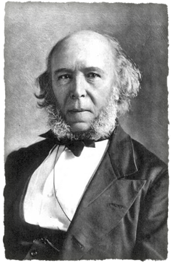
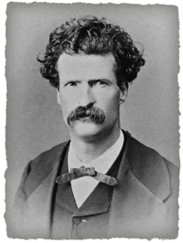
The “Gilded Age” (1870 - 1900)
Coined by Mark Twain
Things appeared to be good on the surface, but underneath there were social, economic, and political issues
Government subsidies fueled westward expansion (RRs)
Emergence of monopolies - to gain power and resources
Businesses looked beyond borders for markets
Social Darwinism - used by wealthy to defend their success
Growing gap between rich and poor - “conspicuous consumption” for the wealthy

Slide 3
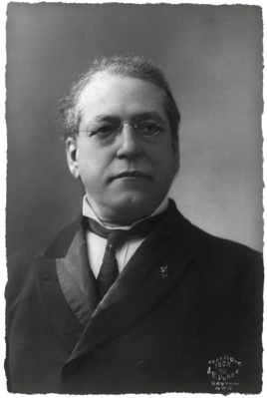
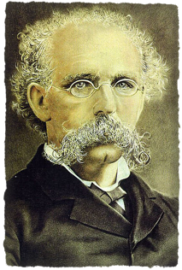
Workforce During The Gilded Age
Expansion of the workforce -> more farmers moving to cities for jobs
Led to lower wages and an increase in child labor
Emergence of unions - sought better working conditions and wages
Knights of Labor - SKILLED and UNSKILLED workers
American Federation of Labor (AFL) - only SKILLED workers
“New South” - sought to bring industrialization to the South
However sharecropping and tenant farming still persisted

Slide 4
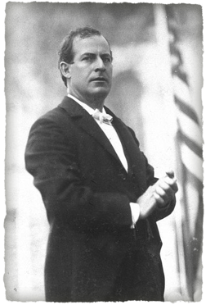
Conflicts During the Gilded Age
Battle over natural resources and land
Corporations v. Conservationists
Example - Sierra Club
Farmers sought to limit the effects of mechanized farming and dependence on RRs
The Grange - Organization of farmers, sought to regulate railroads and grain warehouses
Emergence of the Populist Party:
Wanted increased government control of RRs, telegraphs, etc.
Omaha Platform - election of senators, income tax, regulation of RRs
Many ideas were later adopted during the Progressive Era
Income tax, direct election of senators, secret ballot, etc.

Slide 5
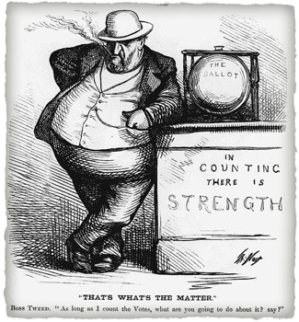
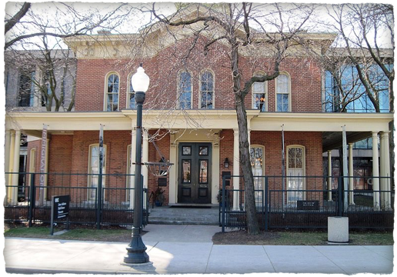
Increase in Urbanization
“New” Immigration - Southern and Eastern Europe
Settled in cities, boomtown areas of the West
Heavily discriminated against - APA
Characteristics of cities:
Divided ethnically, racially, and economically
Provided jobs in factories to large numbers of women, immigrants, and African Americans
Emergence of political machines
Provided social services in exchange for political support
Settlement Houses:
Jane Addams’ Hull House - helped immigrants and women transition to urban life

Slide 6
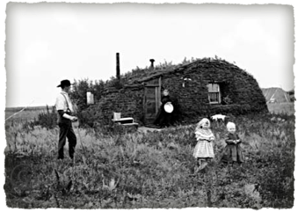
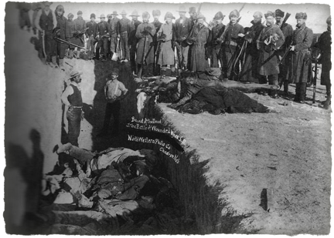
Impact of Transcontinental RR
Westward settlement post-Civil War:
Many migrated due to:
Economic opportunities
Government policies (Homestead Act, subsidies, etc.)
As a result, treaties with Natives were often violated
Violence and conflict often occurred between settlers, Natives, and Mexican Americans as a result of expansion
Government response to Native resistance?
Military force - Chief Joseph, Custer’s Last Stand, Wounded Knee (1890)
Placing Natives onto small reservations
Changing Native identities through assimilation (Dawes Act)

Slide 7
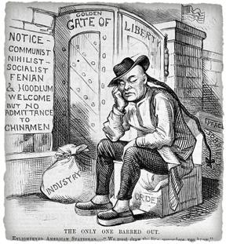

Gilded Age Politics
Focused on economic issues - tariffs, gold v. silver, laissez-faire policies, etc.
Government corruption called for many in the public to seek reform:
Local, state, and national levels
Referendum, Initiative, Recall
Interstate Commerce Act
Increase in nativism and racism
Plessy v. Ferguson - specifically mentioned in the new curriculum
Upheld the Constitutionality of Jim Crow Laws
Chinese Exclusion Act
American Protective Association

Slide 8
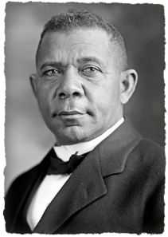
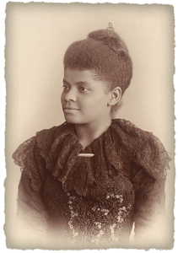
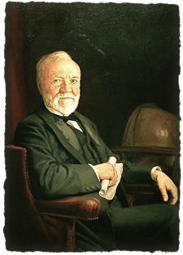
Intellectual Movements
Ways the wealthy justified their approaches and wealth
Gospel of Wealth - written by Carnegie, urged the wealthy to donate money
Social Darwinism - Herbert Spencer, applied Darwin’s ideas to humans
Rich deserved to be rich
Social Gospel:
Protestant Church Movement to improve cities and lives of the poor
Women and African Americans sought to challenge their “place” economically, politically, and socially
Booker T. Washington - encouraged vocational training
Ida B. Wells - outspoken critic of lynching in the South
Elizabeth Cady Stanton - Advocated women’s suffrage

Slide 9
Quick Recap
Emergence of Monopolies
Social Darwinism
Reasons for migration to cities
“New South”
“New” Immigration
Labor unions - AFL and Knights
The Grange
Populist Party
Westward expansion and its impacts on Natives
Plessy v. Ferguson

Slide 10
See You Back Here For Period 7 In 10 Minutes!
Thanks for watching!
Please check out my other videos in the description
Good luck in May!

